Slide 1


Data Science Jobs and Salaries Analysis Using Python Libraries: pandas, matplotlib, seaborn
By Mike Barbiere
02/23/2024

Slide 2

Dataset Description
The "salaries" dataset was mined from a reputable job-portal that contains various postings of data-analytics related positions.
Objective: extract meaningful insights from these data to help explain actual remuneration amounts for specific job titles.
Other variables in consideration included the job category, work setting, experience level, country of company location, etc.

Slide 3
Dataset Description
Columns included in the dataset:
Work Year – the year in which the data were recorded.
Job Title – the specific title of the position (e.g., "Data Scientist, "Data Engineer", etc.)
Job Category -- a classification of the job role into broader categories for easier analysis (e.g., "Machine Learning", "Data Analysis", etc.)
Salary Currency – the currency which the salary is paid in (e.g., USD, EUR, etc.).
Salary – the annual gross salary of the role in the local currency.
Salary in USD – the annual gross salary converted into United States Dollars (USD).
Employee Residence – the country of residence of the employee.
Experience Level – classifies the professional experience level of the employee (e.g., "entry-level").
Employment Type -- specifies the type of employement (e.g., full-time, part-time, etc.)
Work Setting – the work setting or environment (e.g., remote, in-person, hybrid).
Company Location – the country where the company is located.
Company Size -- classifies the size of the company into small (S), medium (M), and large (L) types.

Slide 4
work_year | job_title | job_category | salary_currency | salary | salary_in_usd | employee_residence | experience_level | employment_type | work_setting | company_location | company_size
2023 | Data DevOps Engineer | Data Engineering | EUR | 88000 | 95012 | Germany | Mid-level | Full-time | Hybrid | Germany | L
2023 | Data Architect | Data Architecture and Modeling | USD | 186000 | 186000 | United States | Senior | Full-time | In-person | United States | M
2023 | Data Architect | Data Architecture and Modeling | USD | 81800 | 81800 | United States | Senior | Full-time | In-person | United States | M
2023 | Data Scientist | Data Science and Research | USD | 212000 | 212000 | United States | Senior | Full-time | In-person | United States | M
2023 | Data Scientist | Data Science and Research | USD | 93300 | 93300 | United States | Senior | Full-time | In-person | United States | M

Slide 5

Exploratory Data Analysis
Analyzing and investigating the dataset to summarize the main characteristics and create pertinent data visualizations.

Slide 6
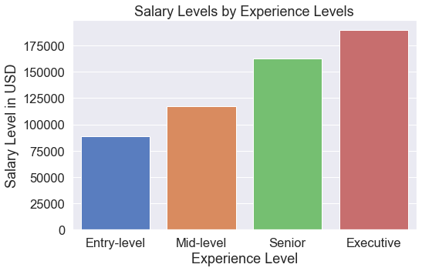
Average Salary Levels by Experience Level
When jobs are grouped by experience-levels, its apparent that there's a greater salary associated with higher experience levels, on average.

Slide 7
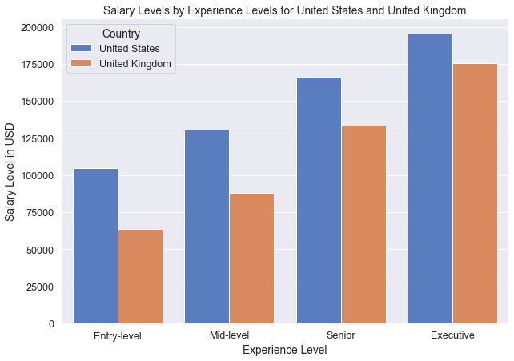
Salary by Experience Level: United States vs. United Kingdom
The same trend is prevalent here, except the salary levels are greater in the US across all experience levels, on average.

Slide 8
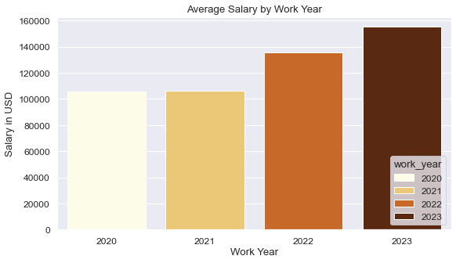
Average Salary by Work Year
The average salary has increased across the work year in which a specific job was posted.
Note: work year data are unbalanced, heavily right skewed.

Slide 9
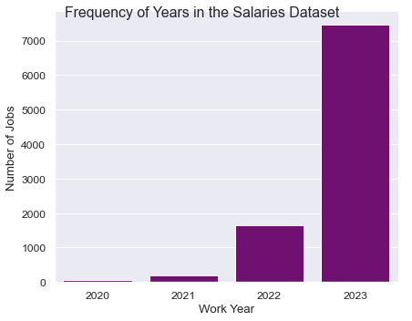
Frequency of Work Year Entries
As noted previously, these data were collected very recently. Therefore, the predominance of entries in the dataset are from 2023.

Slide 10
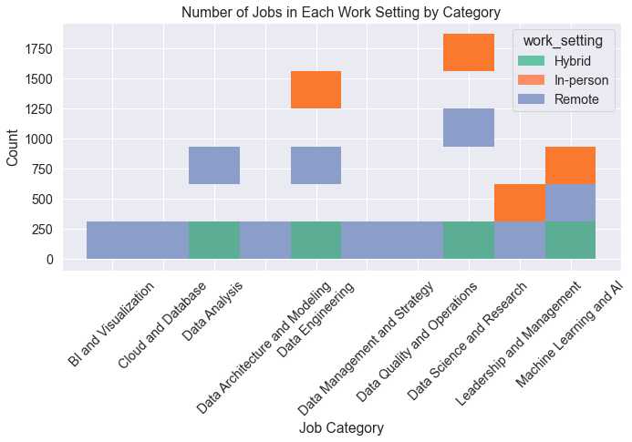
Distribution of Job Categories by Work Setting
The number of job-positions in each work setting by the specified Job Category is shown here.
Every job category includes a "remote" position; but these number fewer than those job categories with "in-person" settings.

Slide 11
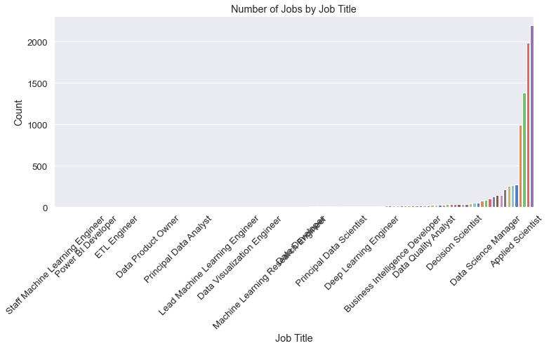
Frequency of Job Titles
This shows the sheer number of varying job titles in the dataset. There are only a handful of key job-titles that occur repeatedly.
These include Applied Scientist, Data Science Manager, Data Scientist, etc.

Slide 12
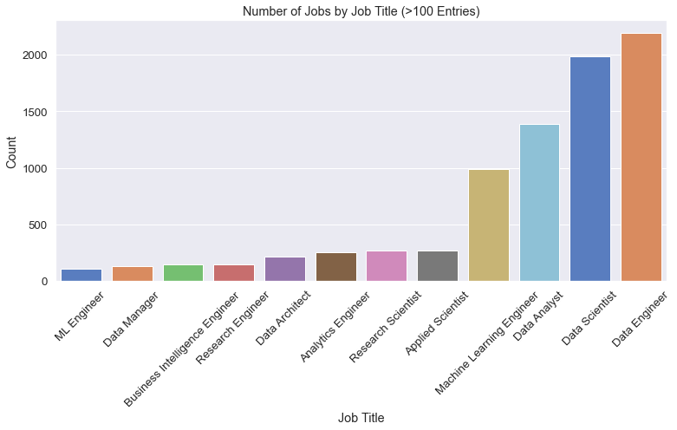
Filter the Most Commonly Occurring Job Titles
This graph shows the data grouped by job title, depicted earlier, but only includes the titles that occur more than 100 times in the dataset.
The top five include: Data Engineer, Data Scientist, Data Analyst, Machine Learning Engineer, and Applied Scientist.

Slide 13
Create Merged Dataset: Count and Salary in USD by Job Title
job_title | count | salary_in_usd
0 | Staff Machine Learning Engineer | 1 | 185000.000000
1 | Data Science Tech Lead | 1 | 375000.000000
2 | Machine Learning Operations Engineer | 1 | 60000.000000
3 | Consultant Data Engineer | 1 | 118539.000000
4 | Manager Data Management | 1 | 125000.000000
5 | Cloud Data Architect | 1 | 250000.000000
6 | Managing Director Data Science | 1 | 300000.000000
7 | Marketing Data Engineer | 1 | 66970.000000
8 | Power BI Developer | 1 | 64781.000000
9 | BI Data Engineer | 1 | 60000.000000
10 | Deep Learning Researcher | 1 | 124163.000000
11 | Analytics Engineering Manager | 1 | 399880.000000
12 | Sales Data Analyst | 1 | 60000.000000
13 | AWS Data Architect | 1 | 258000.000000
118 | Analytics Engineer | 256 | 155239.132812
119 | Research Scientist | 269 | 184375.583643
120 | Applied Scientist | 272 | 190171.606618
121 | Machine Learning Engineer | 991 | 184785.883956
122 | Data Analyst | 1388 | 109911.472622
123 | Data Scientist | 1989 | 156681.015083
124 | Data Engineer | 2195 | 146620.095216
Count the number of positions per job title. Then select the average salary by job title, and filter by the top 95% and bottom 5% in average salary level.
Finally, these two datasets get merged to create the target dataset, pictured adjacent here.
Columns included: job title, count, and salary in USD.

Slide 14
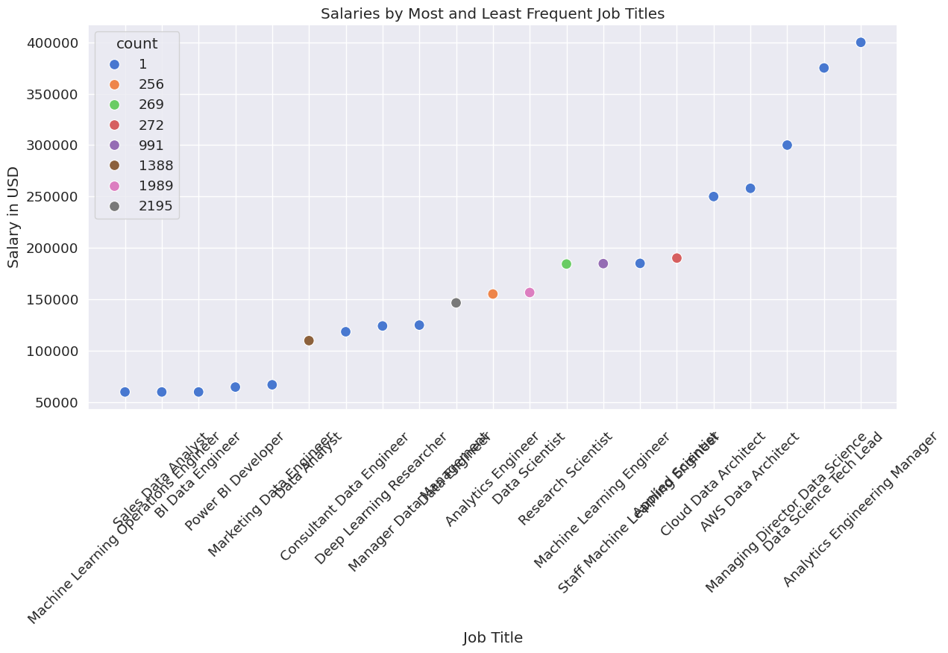
Salaries by Most and Least Commonly Occurring Job Titles
Some of the most and least lucrative positions are those that unique in the dataset (i.e., only occur once).
The most common job titles have a good salary, but remuneration varies.

Slide 15
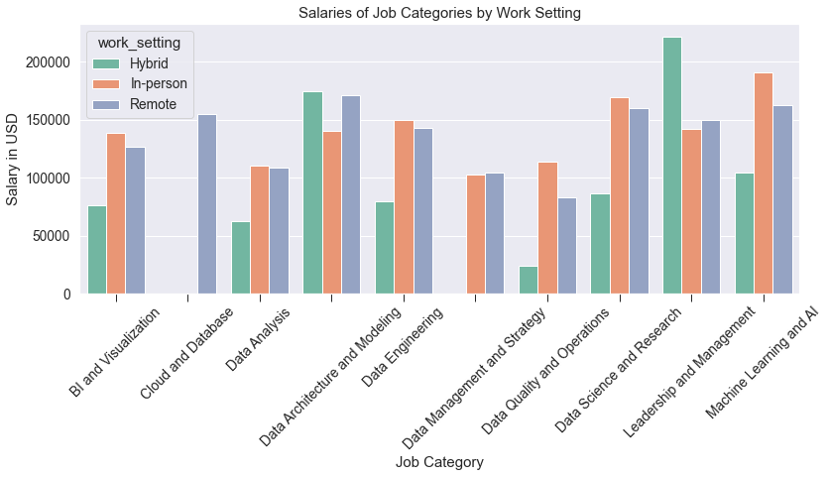
Salaries by Work Setting of the Job Categories
Average salary varies by work setting, and by job category.
There is more variability for "hybrid" positions.
"In-person" and "remote" positions are comparable in salary across job category.

Slide 16
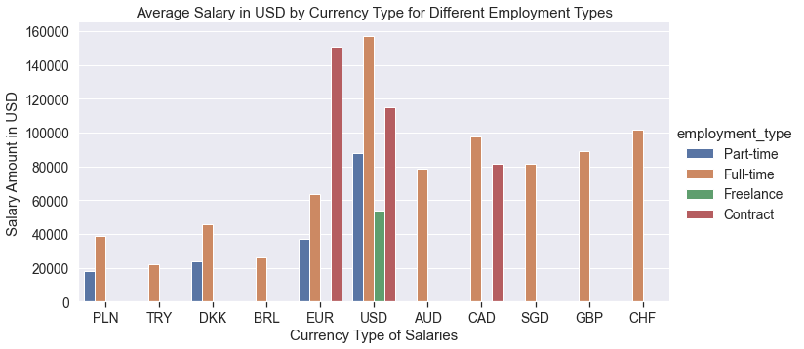
Average Salary by Currency Type (in USD) for Different Employment Types
Full-time positions pay the most. Also, jobs in the US include all employment types.

Slide 17
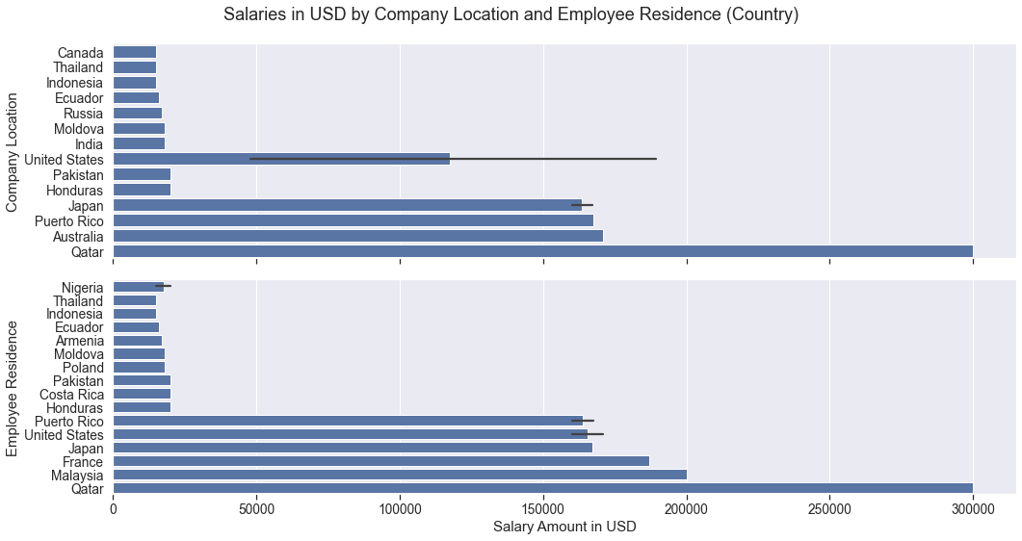
Salaries by Company Location and Employee Residence
Salaries in the United States have the most variance. Employee location also varies considerably.

Slide 18
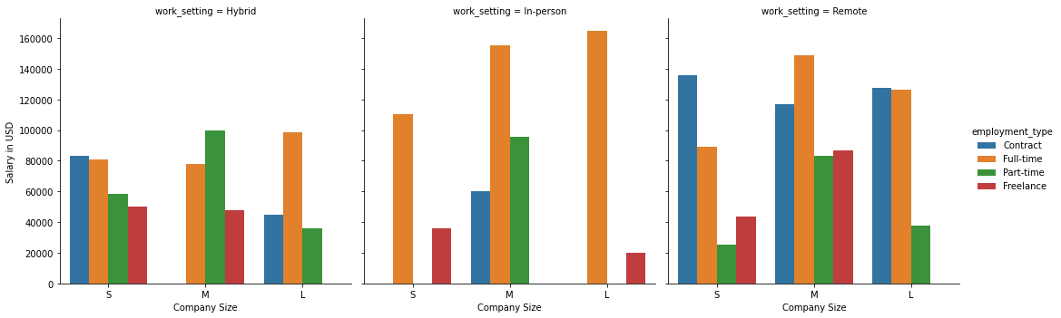
Salaries by Work Setting and Company Size
Remote positions offer the most employment types. But in-person positions pay more for full-time workers.

Slide 19
Dataset and Python Notebook on Github
https://github.com/Barbj379/Oeson_Learning.git
"Project 2"

Slide 20

Thank you!

